Slide 1
Hotel Booking and Cancellation Prediction

Slide 2
Group Member Information
Lenkala Manisha Reddy –(700742259)
Bala Rishik Marneni –(700746746)
Satya Sandeep Reddy Sangati –(700745458)

Slide 3
Roles & Responsibilities
Name | Responsibilities
Satya Sandeep Reddy | Implemented the best feature selection methods and worked on the SVM model and by evaluating the test data by constructing the test report and implemented the code as well for those methods with team.
Manisha Reddy | Worked on designing the flowchart and implemented the naïve bayes classifier method and evaluate those methods using test data and calculated the classification report from it and worked on the final document.
Bala Rishik | Performed some operations on cleaning the raw data and outlier detection removal and worked on the feature selection methods with team and documented the results from the models and reviewed the code as well.

Slide 4
Motivation
In the hotel management system, booking cancellation act as a major part for decision making regarding associated demands. It affects the services and revenue of the hotel and estimates relevant outputs.
The authority of hotel management are concerned about customer’s requirement by analysing these process.
The online reservation system is one of the most attractive solutions in the hospitality industry. So, when a reservation has been cancelled, the hotel will be harmed, this is because the room that was previously usable can become unusable on the day the user ordered.
Predicting the Customer behavior and the factors that effect the causes of cancellation cannot be calculated manually. So, we will use machine learning algorithms to find the patterns in the given data and predict the classes.

Slide 5
Objectives
Hotel booking cancellation is provided a substantial effects on demand management decisions in the hospitality industry.
The goal of this work is to investigate the effects of different machine learning methods in hotel booking cancellation process.
Selecting best features from the various feature selection methods and Implementing the machine learning algorithms and Conducting comparative analysis as well.
Implementing the 3 types of feature selection methods Univariate, Feature importance, Correlation matrix and Outlier detection with the help of algorithms such as the SVM and Naive Bayes.

Slide 6
Related Work
For hotel management it is important to assess the behavior of the customers and make the decisions for business cases. In this study we have collected the dataset from Kaggle repository.
Using the feature selection methods we have eliminated the insignificant features from the data and gathered the significant features to process.
In this study we analyze the behavior of the customer who frequently visits the hotels and divided the segments into three categories.
Based on the segmentation of the behavior of customer is done using the unsupervised machine learning algorithm.
With the help of machine learning algorithms like SVM and Naive’s Bayes algorithms we followed the manner like preprocessing the data, feature encoding and feature engineering the models give the high accuracy.

Slide 7
Problem Statement
With the increasing day to day trend of hotel cancellation at border time, it affects the local as well as international tourists more and more. Customer/Tourists don't have any idea about the pre-cancellation scenario of particular hotel at the time of booking of that hotel.
The cancellation of bookings likely plays a pivot role to their revenue and also its leads to low rankings on travelling applications sites makes very difficult to gain customer satisfaction.
Cancellation of bookings or room reservations through the online system is currently one of the problems in the hotel management system.

Slide 8
Proposed Solution
The main aim of a Hotel Booking and Cancellation prediction is to develop a predictive model that can accurately forecast whether a hotel booking is likely to be cancelled or not.
With the help of these machine learning algorithms we can analyze this data, a predictive model can be developed that can accurately forecast the likelihood of a booking being cancelled.
This model can be used to help hotels to identify high-risk bookings, prioritize them for further analysis and evaluate the models performance using appropriate metrics such as the accuracy, precision, recall and F1score.

Slide 9
Results
We implemented the machine learning algorithms such as the SVM and Naïve Bayes classifier to classify the booking status.
To classifying the status of booking we classify the status of booking is 1 and the booking stats is 0 then it categorized as cancelled.
Various performance metrics such as precision, recall, and F1 score were used to evaluate the models performance on the test set , and a confusion matrix was conducted.
Firstly, we have constructed the classification report and confusion matrix for Univariate feature selection and Feature importance methods.
We can conclude that In case Univariate selection method Naive Bayes Classifier performed well with the accuracy of 99 percent and in case of feature importance SVM classifier performed well with the accuracy of 75 percent.

Slide 10
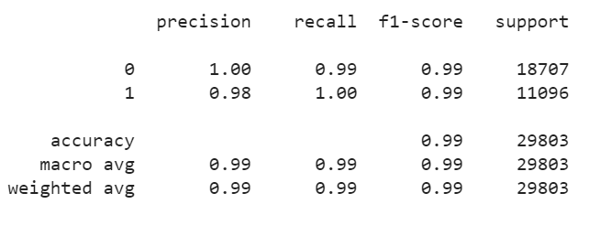
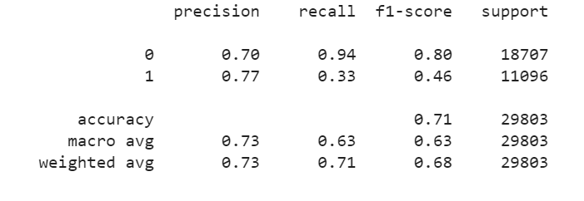
Here its shows the results of the both Naive Bayes classifier report and classification report SVM for Univariate selection and clearly shows that Naive Bayers performed well with an accuracy of 99 percent than that of SVM with an accuracy of 75 percent.
Results
Naive Bayes classifier report Univariate selection
Classification report SVM after Univariate selection

Slide 11
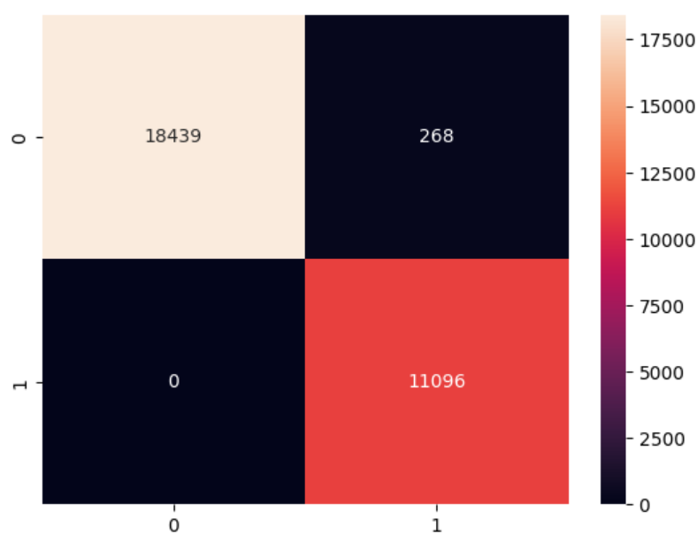
Confusion Matrix Results
The confusion matrix gives the combination of correct classifications and mis classification samples in the test cases. Confusion matrix is a symmetric matrix. The diagonal values give the True positives and True negatives.

Slide 12
References
[1].M. V. Rakesh, S. P. Kumar, Yogitha and R. Aishwarya., "Hotel Booking Cancelation Prediction using ML algorithms," 2022 Second International Conference on Artificial Intelligence and Smart Energy (ICAIS), Coimbatore, India, 2022, pp. 466-471, doi: 10.1109/ICAIS53314.2022.9742843.
[2] D. Asir Antony Gnana Singh, A. Escalin Fernando, and E. Jebamalar Leavline. Experimental study on feature selection methods for software fault detection. In 2016 International Conference on Circuit, Power and Computing Technologies (ICCPCT), pages 1–6, 2016.
[3]Sanjukta Mohanty, Monalisha Sahoo, and Arup Abhinna Acharya. Predicting phishing url using filter based univariate feature selection technique. In 2022 Second International Conference on Computer Science, Engineering and Applications (ICCSEA), pages 1–5, 2022.

Slide 13
Thank You!!!

